Slide 1


ANALYZING CUSTOMER PURCHASES BEHAVIOUR
Team 1 :
Ghaida Takrooni
Sirisha Ginnu
Long Huynh
Ujjawal Dwivedi

Slide 2

AGENDA
INTRODUCTION
DATA OVER VIEW
EXPLANATORY DATA ANALYSIS
SMART QUESTIONS

Slide 3

INTRODUCTION
Understanding the factors that influence purchase frequency is crucial for businesses aiming to enhance customer engagement and optimize marketing strategies. In research paper we aim to dissect the correlations between purchase frequency and various customer characteristics, and behavioral aspects. By identifying key influencers of purchase behavior, companies can tailor their marketing efforts more effectively, potentially increasing customer loyalty and sales.

Slide 4
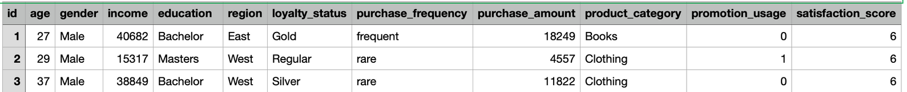
DATA OVERVIEW
100,000 ENTRIES
12 COLUMNS
Descriptive Statistics:
Age: The average age of customers is approximately 30 years, with a minimum of 12 and a maximum of 49 years.
Income: The average income is about $27,516 with a wide range from $5,000 to $50,000.
Purchase Amount: Average spending is around $9,634, ranging from $1,118 to $26,204.
Promotion Usage: About 30% of transactions use promotions.
Satisfaction Score: The average satisfaction score is slightly above 5, on a scale from 0 to 10.

Slide 5
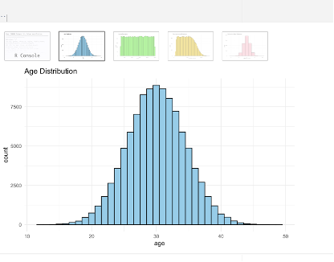
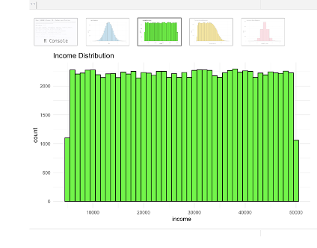
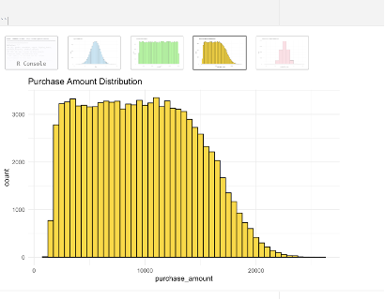
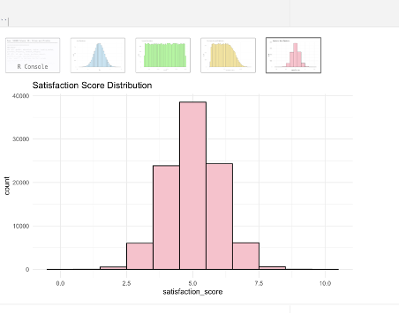
DATA OVERVIEW
Age Distribution: The distribution of age appears roughly normal but slightly right-skewed, indicating a higher frequency of younger customers.
Income Distribution: Income also exhibits a right-skewed distribution, with many customers earning towards the lower end of the scale.
Purchase Amount Distribution: Purchase amounts are right-skewed, with most purchases clustering at the lower end of the amount spectrum.
Satisfaction Score Distribution: This shows a relatively uniform distribution across the scores, with slight peaks around the lower and upper bounds.

Slide 6
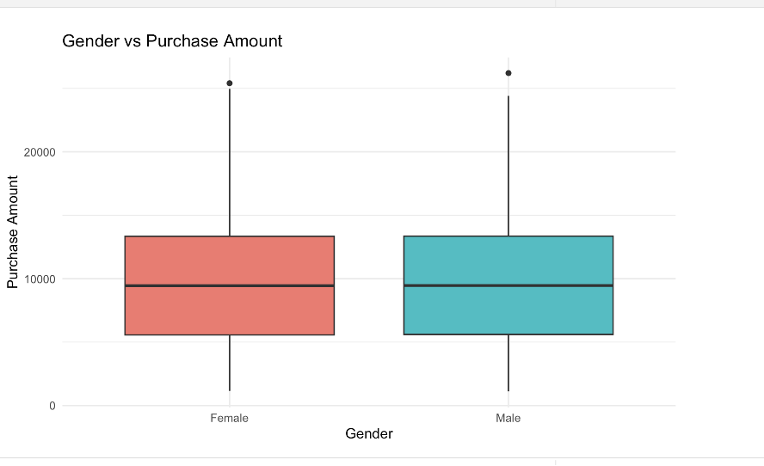
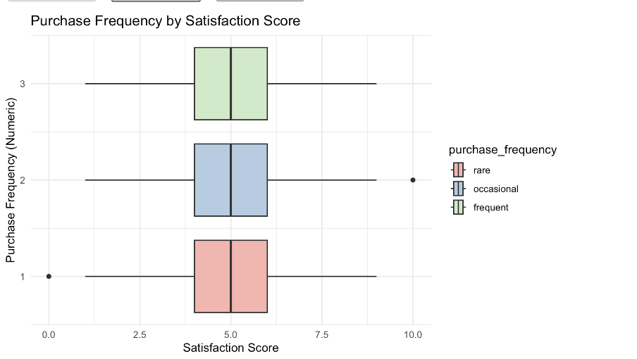
RELATIONSHIPS AND INSIGHTS
For a clear visual comparison of gender versus purchase amount, a boxplot or a violin plot would be appropriate. These types of plots are excellent for displaying the distribution of a numerical variable across the levels of a categorical variable.

Slide 7

SMART QUESTIONS
Q1: What is the correlation coefficient between income levels and purchase frequency among customers?
Q2: How does customer satisfaction score influence the frequency of purchases in the dataset?
Q3: Can we segment customers effectively based on their purchasing behavior and demographic factors by the next marketing cycle?

Slide 8
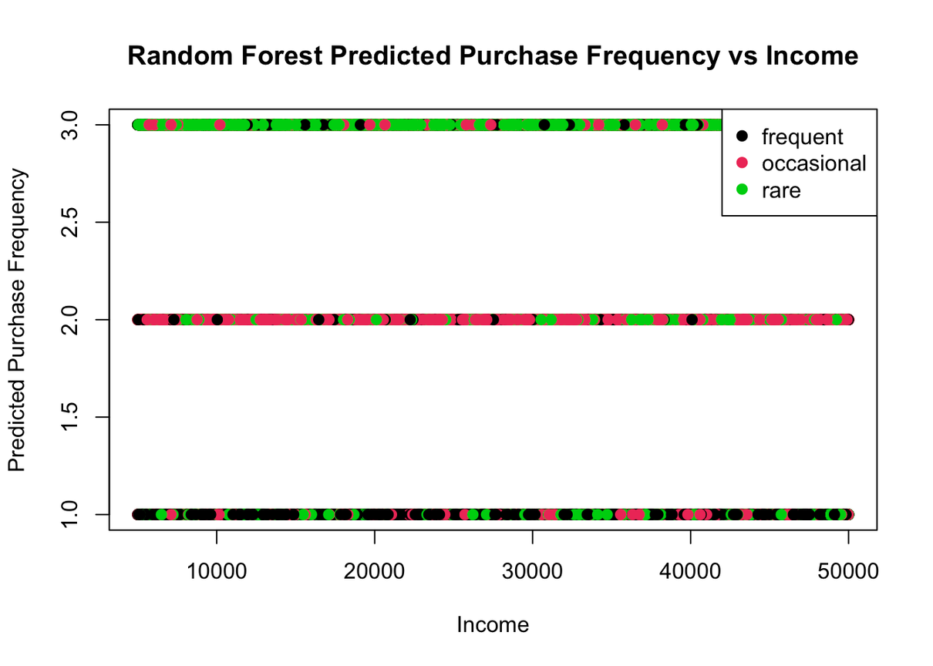

SMART QUESTION 1:
MeanDecreaseAccuracy: A negative value suggests that including the 'income' variable in the model does not contribute to an increase in the accuracy of the model.
MeanDecreaseGini: The high Gini decrease value for 'income' suggests that it's an important variable for creating distinct groups or nodes within the Random Forest
There does not appear to be a clear trend that would indicate higher income leads to a specific purchase frequency category.

Slide 9
SMART QUESTIONS 2:
Given that 'purchase_frequency' is a categorical variable and 'satisfaction_score' is numerical, we can use machine learning classification algorithms to predict 'purchase_frequency' based on 'satisfaction_score'.
Multinomial Logistic Regression
The model doesn't predict a clear increasing or decreasing trend, indicating that within this model's context, satisfaction score alone may not be a strong predictor of purchase frequency.
k-NN
There is a relationship where certain ranges of satisfaction scores are associated with specific purchase frequencies.
Random Forest
The random forest seems to have a bit of a mix in its predictions across satisfaction scores for different purchase frequencies.
These results imply that for businesses looking to understand and predict customer purchase frequency, it may be beneficial to consider a broader range of factors beyond just customer satisfaction scores.

Slide 10
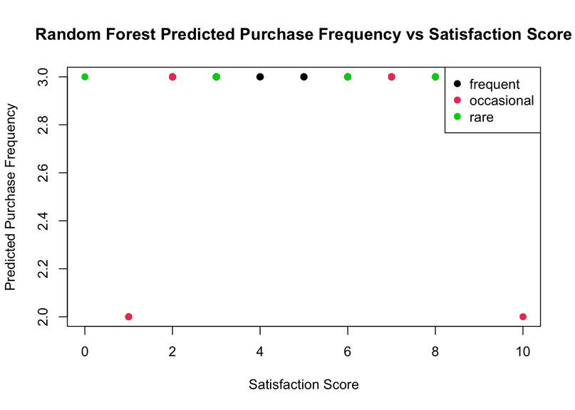
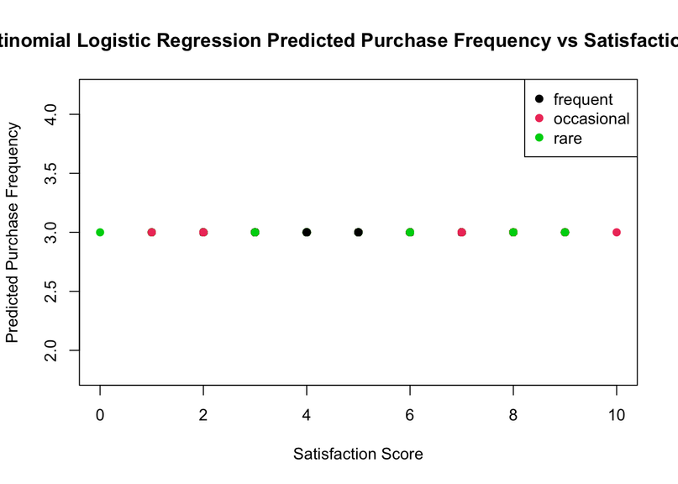
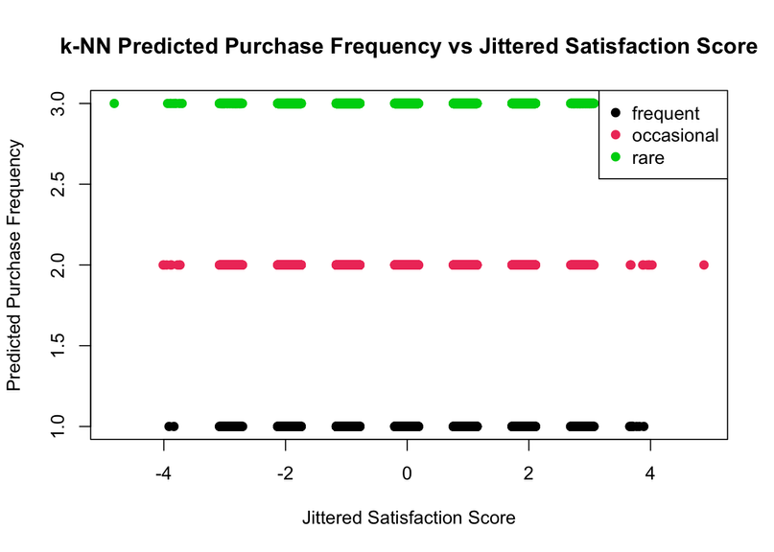
SMART QUESTIONS 2:

Slide 11
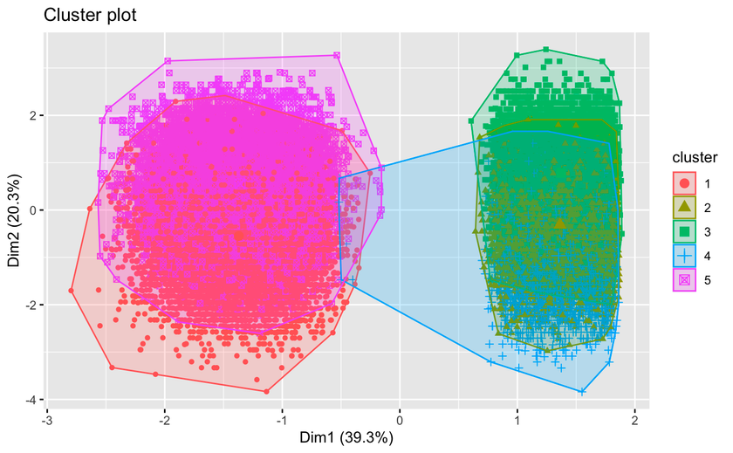
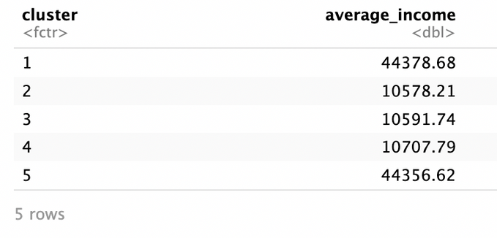
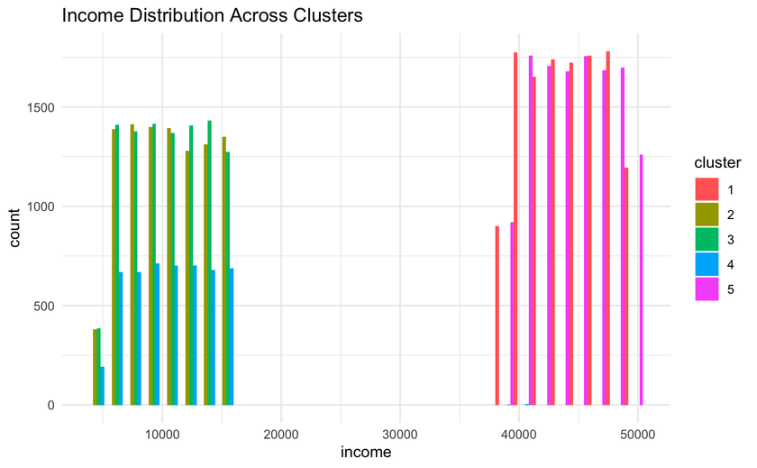
SMART QUESTIONS 3:
CLUSTER 1 (RED): THIS CLUSTER HAS AN AVERAGE INCOME OF APPROXIMATELY $44,378.68. FROM THE WE CAN SEE THAT THIS CLUSTER PRIMARILY REPRESENTS HIGHER-INCOME CUSTOMERS.
Cluster 2 (Green): The average income for this cluster is around $10,578.21. Customers in Cluster 2 are primarily in the lower income brackets based on the histogram.
Cluster 3 (Blue): Similar to Cluster 2, this cluster also has a low average income, approximately $10,591.74.

Slide 12
SMART QUESTIONS 3:
Cluster 4 (Turquoise): This cluster's average income is about $10,707.79, which is again in the lower income range, similar to Clusters 2 and 3. The histogram suggests that Clusters 2, 3, and 4 likely represent a range of customers with lower economic backgrounds, perhaps varying by other factors like purchase frequency, education, or region.
Cluster 5 (Pink): With an average income of $44,356.62, this cluster also represents higher-income customers.
Notes:
he histogram distributions and average incomes indicate that there are two distinct economic segments among the clusters: one with higher income (Clusters 1 and 5) and the other with lower income (Clusters 2, 3, and 4). For marketing purposes, different strategies could be developed for these segments. For instance, more luxurious or high-end products could be marketed to Clusters 1 and 5, while more economical options could be tailored to Clusters 2, 3, and 4. Other demographic and behavioral factors could further differentiate these clusters, providing additional targeting opportunities for marketing campaigns.

Slide 13
CONCLUSION

Slide 14

THANK YOU,
QUESTIONS?

